Slide 1




ENGLISH YEAR 4
MODULE 4
CELEBRATIONS

Slide 2





Welcome, students!

Slide 3


By the end of the lesson, pupils will be able to:
Understand with support, the main idea of longer simple texts.
Guess the meaning of unfamiliar words from clues provided by title and topic.
Learning
Objectives

Slide 4




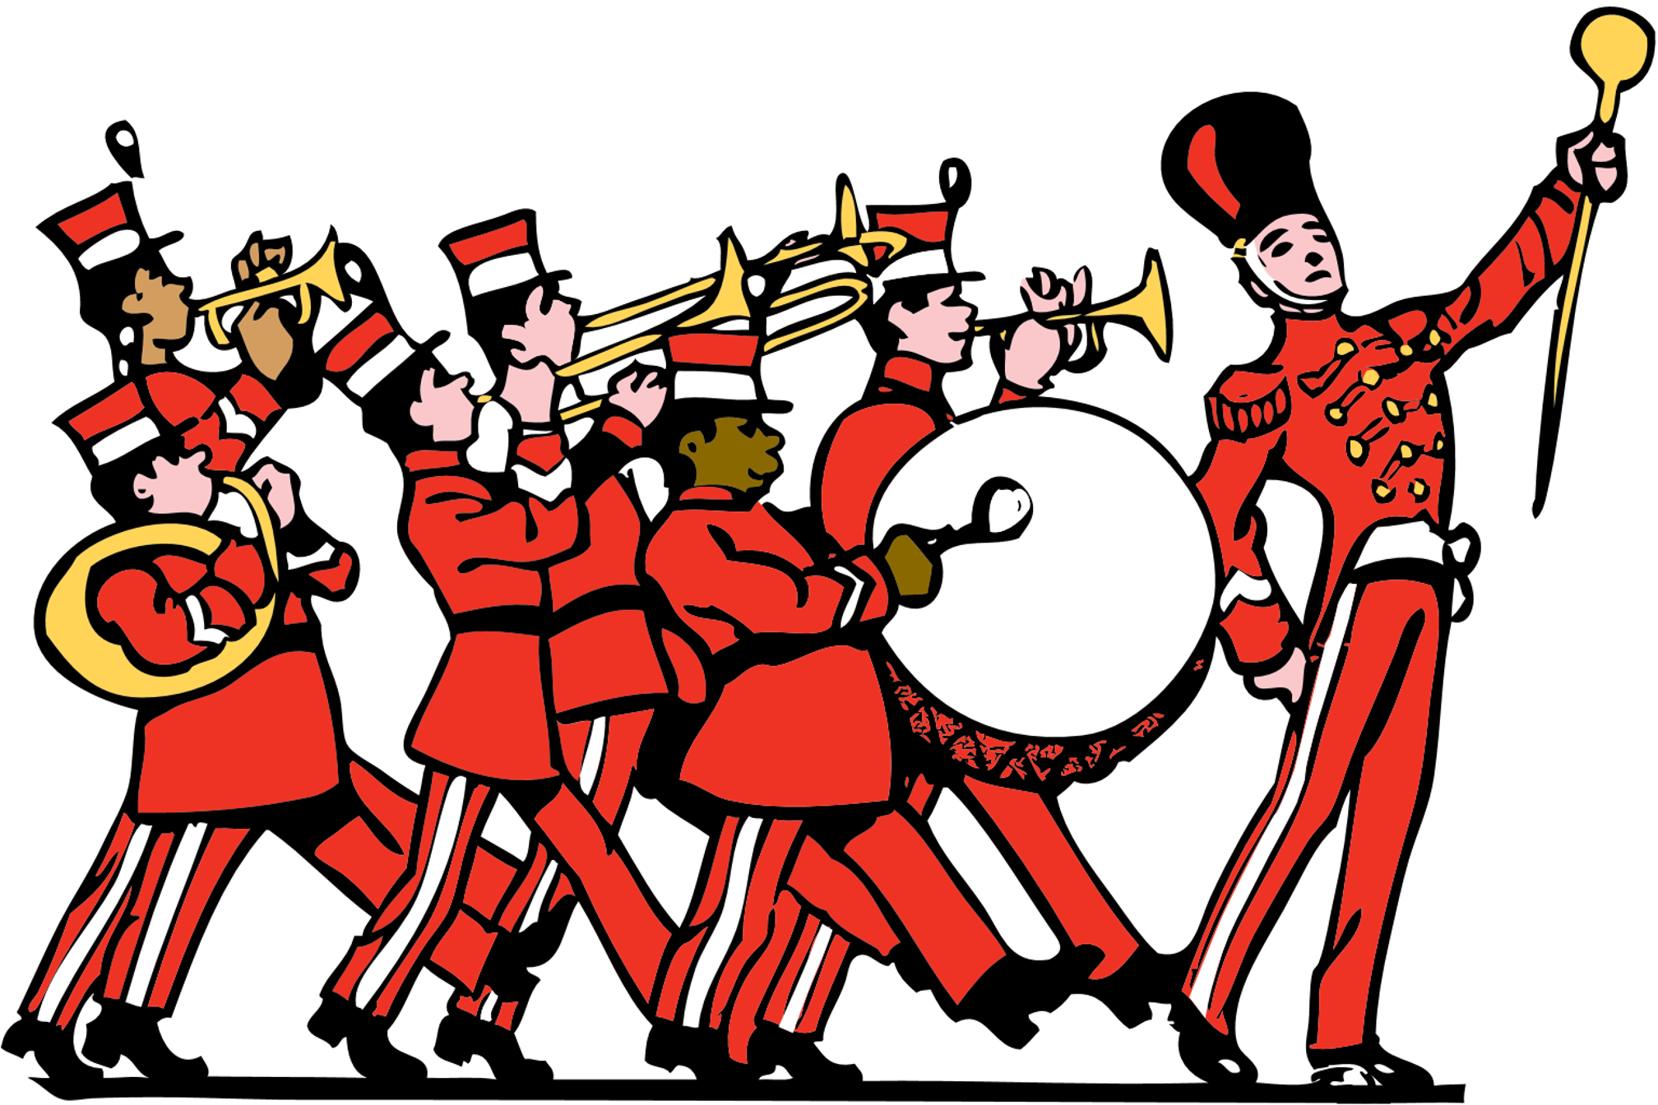

Look at this picture
What do you see in this picture?
Have you been to a parade?
What are the few activities that take place at a parade?

Slide 5
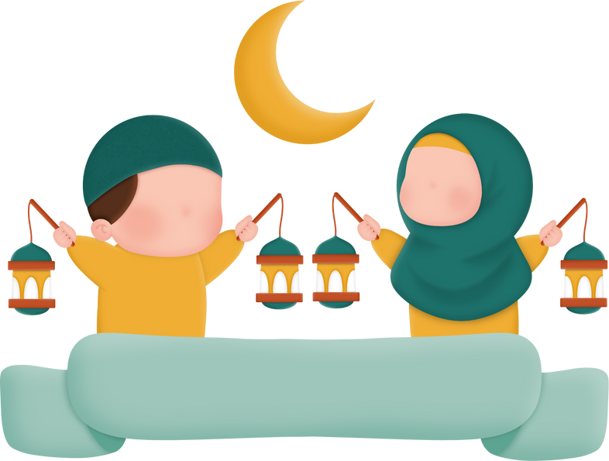

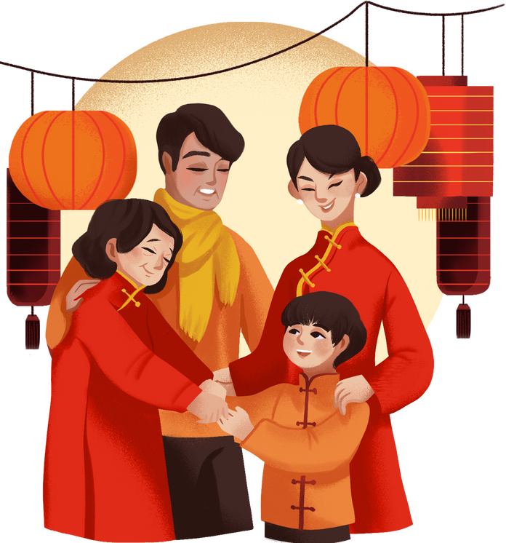

What are some of celebrations we celebrate?

Slide 6

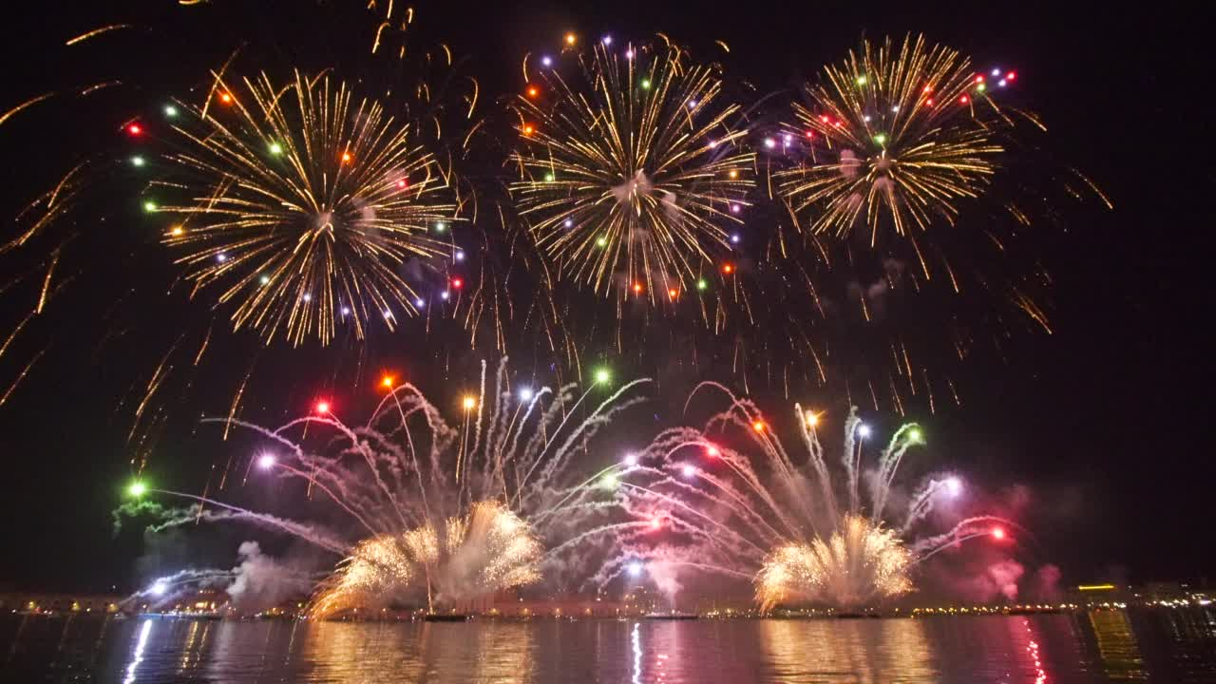


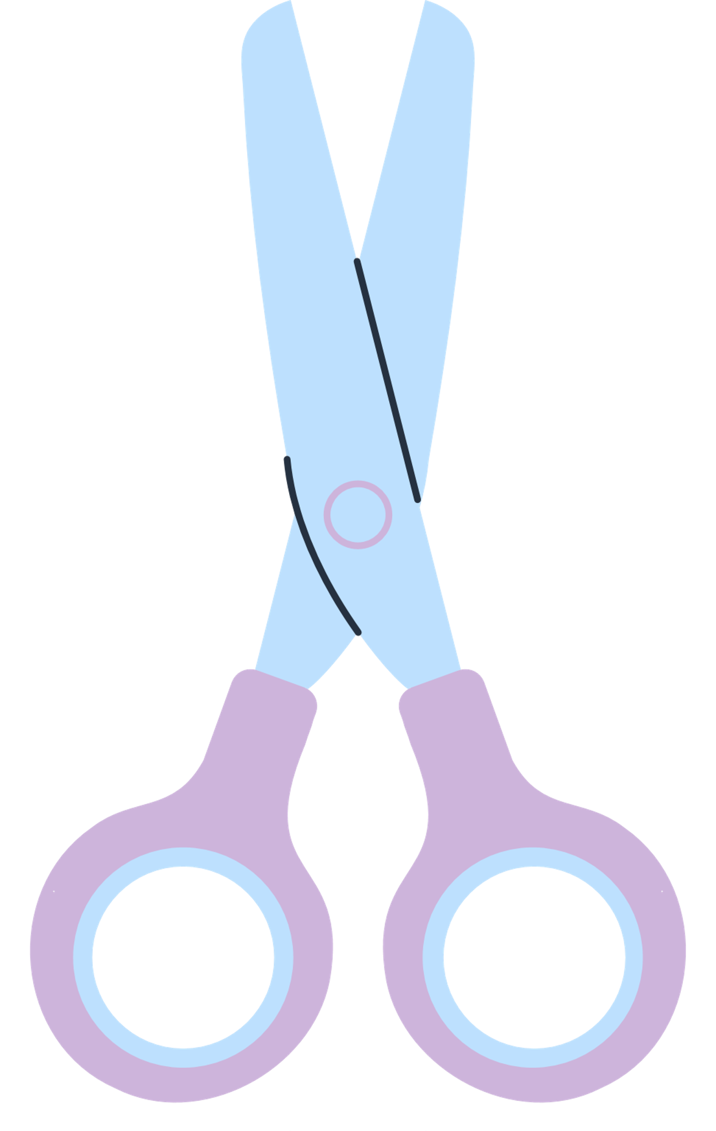

Activity Time
Choose one celebration and talk about what you do on that day. It may be a celebration that only your family celebrates.

Slide 7
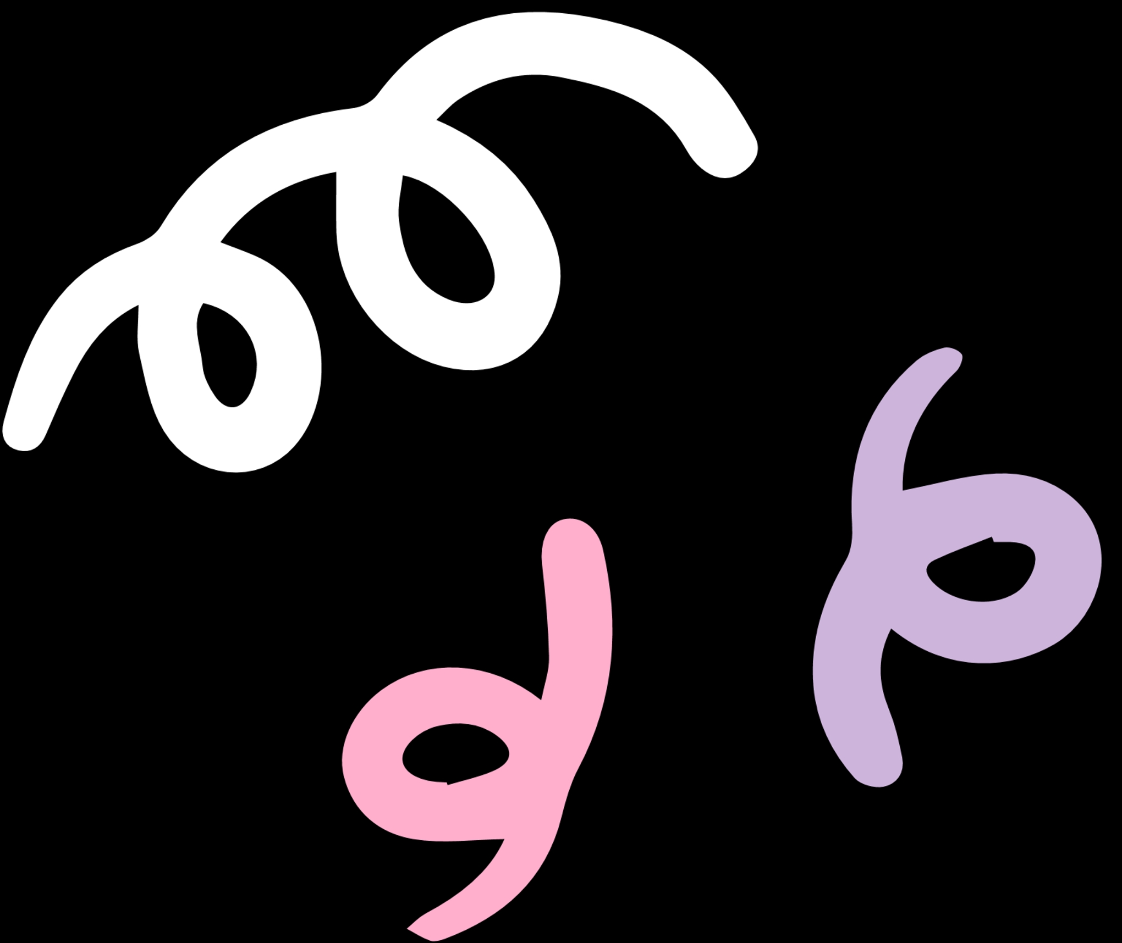
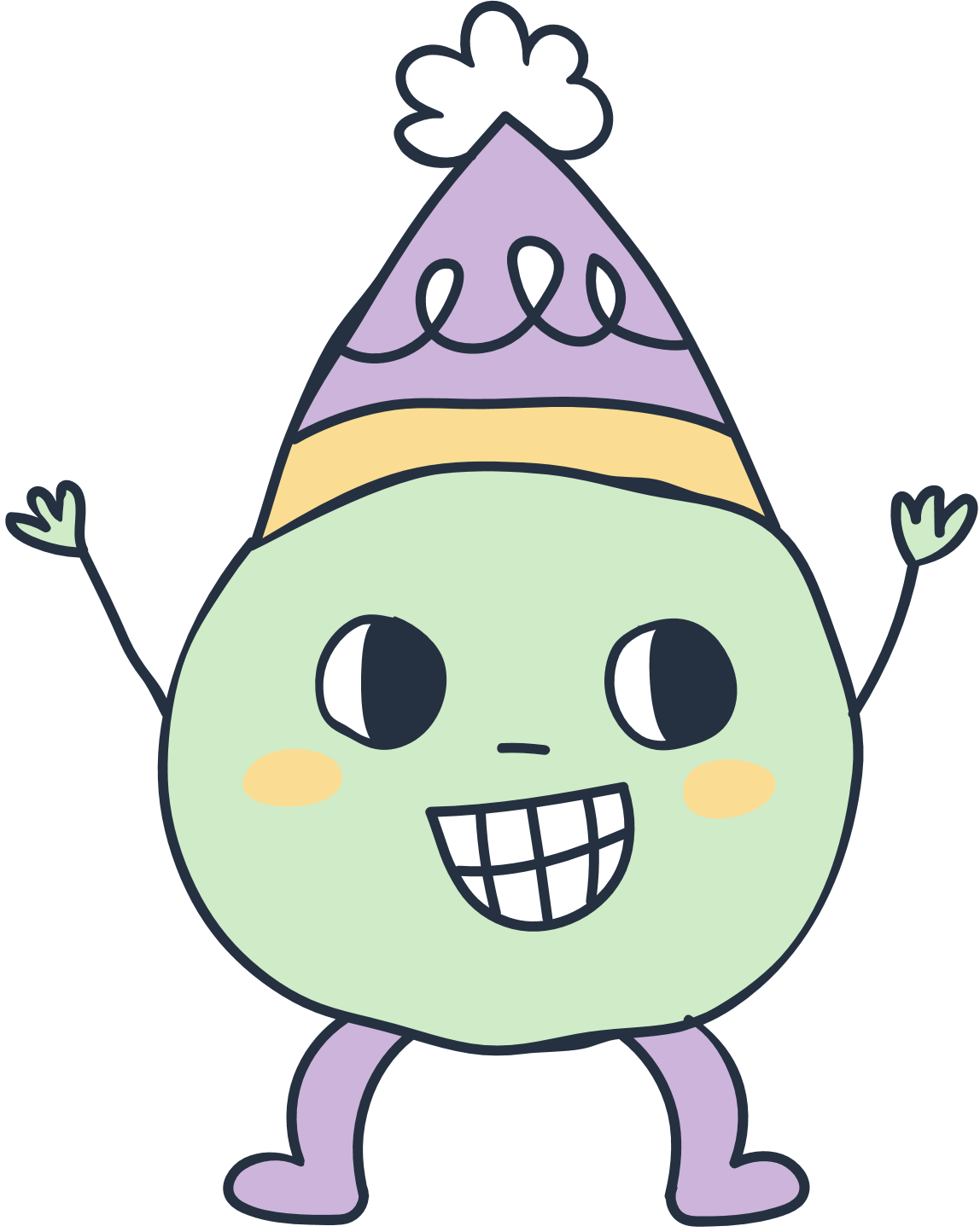
What are the different types of celebrations we celebrate in Malaysia?
What did we learn about parades?
Class Recap
What do we do on special days?

Slide 8
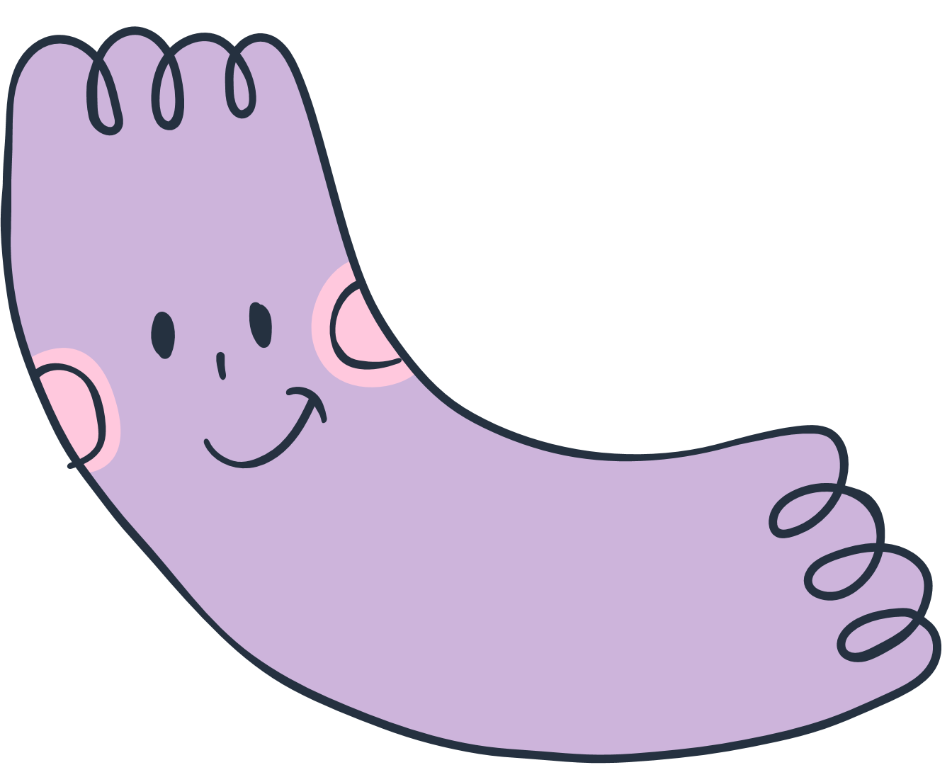


THANK YOU
See you next time!

